Slide 1
The Relational Database Model

Slide 2
Content
Table
Keys
Integrity rules
Relational set operators
The data dictionary
Relationships within the relational database
Index

Slide 3
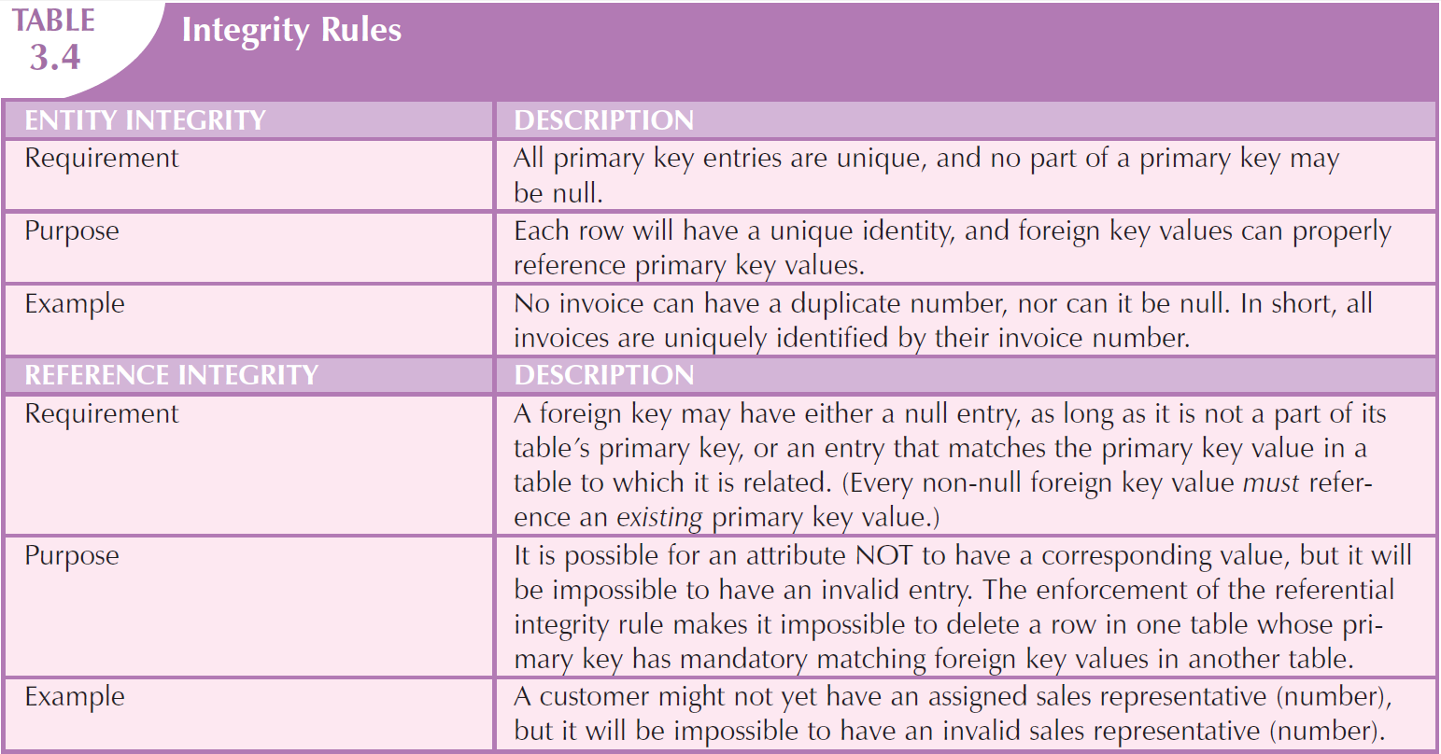
Integrity Rules 完整性约束

Slide 4
Entity Integrity 实体完整性
Requirement 要求
所有的主键(primary key)记录都必须是唯一的，主键的任意部分都不能为空值(null)。
Purpose 目的
每一行（每一个记录）都必须有唯一的标识，并且外键(foreign key)值可以正确的对应主键(primary key)值。
Example 举例
所有发票号码都不重复，也不可以为空值，所有发票都可以被发票号唯一标识。

Slide 5
Reference Integrity 参照完整性
Requirement 要求
一个外键，只要不是表格主键的一部分，可以是空值，或者是相关表格里主键相对应的值。（每一个非空值的外键必须参照一个现有的主键值）
Purpose 目的
一个属性可能没有对应的值，但它不可能有一个无效值。使用参照完整性，如果表格主键值在另外一张表格的外键有对应的值，那么该主键值不可能被删除。
Example 举例
一个客户可能没有指定的销售人员（号码），但他一定不可能有一个无效的销售人员（号码）。

Slide 6
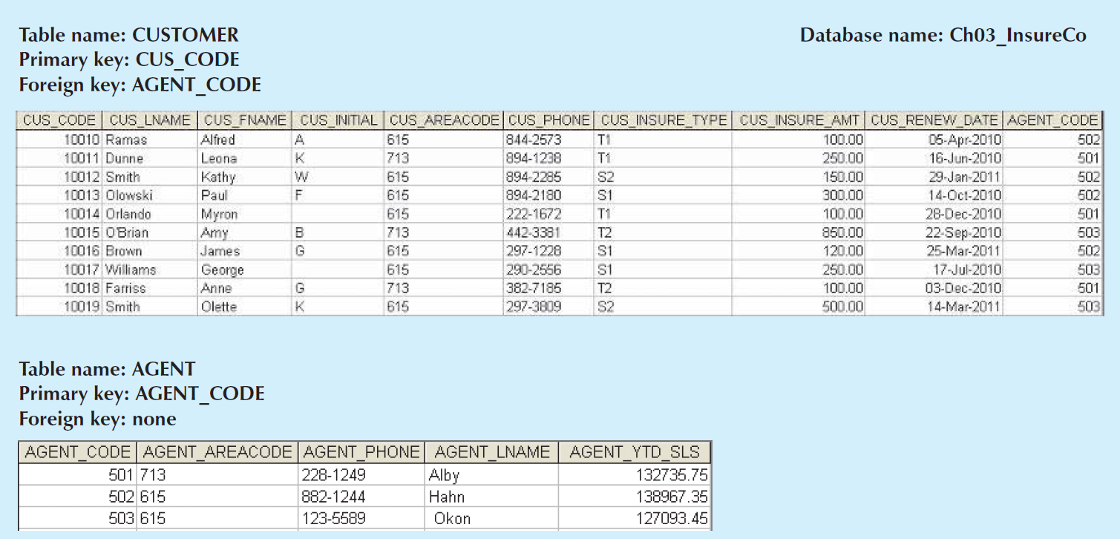
An illustration of integrity rules

Slide 7
Relational Set Operators
Data manipulation capabilities
Relational algebra 关系代数
SELECT 选择
PROJECT 投影
UNION 并
INTERSECT 交
DIFFERENCE 差
PRODUCT 笛卡尔积
JION 连接
DIVIDE 除

Slide 8
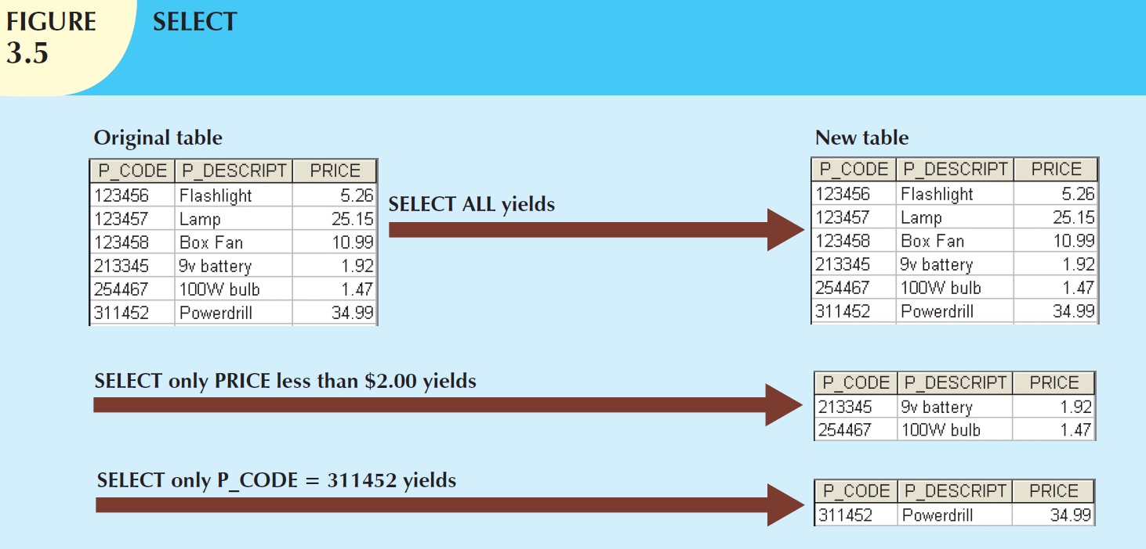
SELeCET 选择
Yields values for all rows found in a table the satisfy a given condition.
SELECT * FROM school.`student table`;

Slide 9
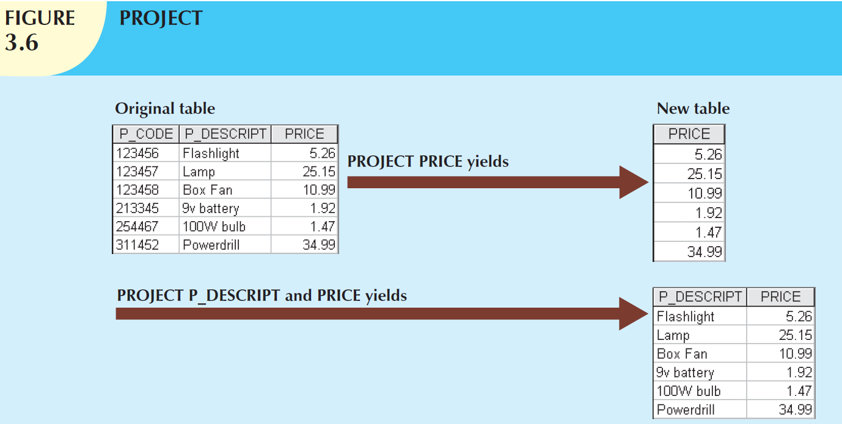
PROJECT 投影
PROJECT yields all values for selected attributes.
PROJECT yields a vertical subset of a table.
SELECT `Name` FROM school.`student table`;

Slide 10
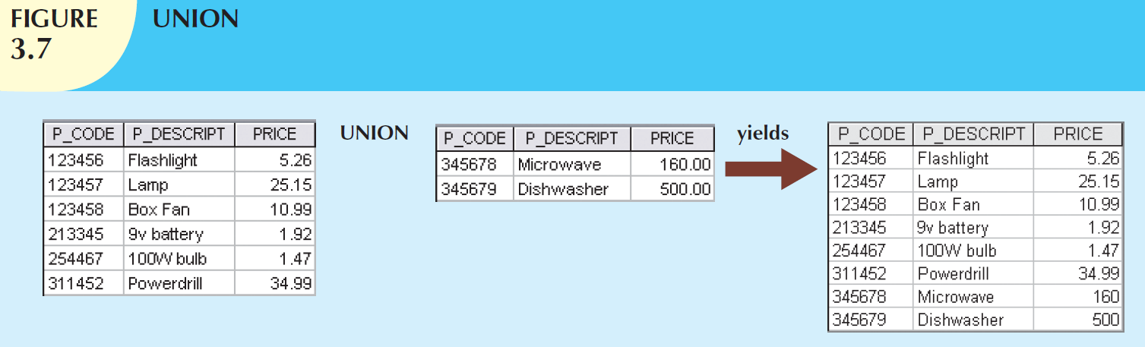
UNION 并
Combines all rows from two tables, excluding duplicate rows.
The tables must have the same attribute characteristics (the columns and domains must be compatible).
SELECT `CourseID` FROM `course table`
union
SELECT `Sid` FROM `student table`;

Slide 11
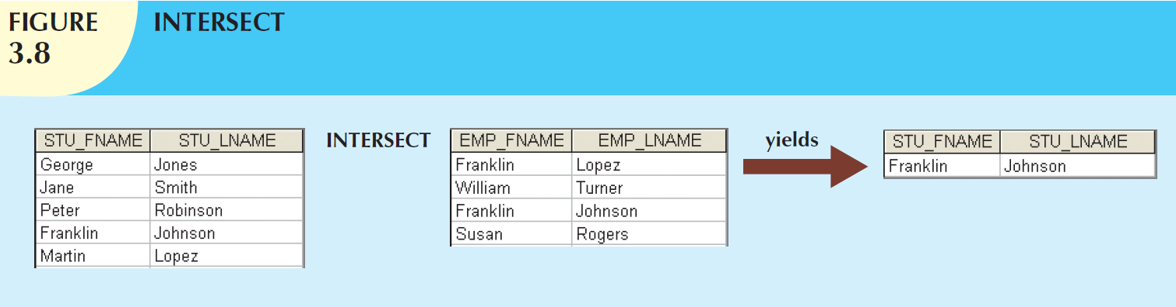
INTERSECT 交
Yields only the rows that appear in both tables.
Mysql workbench 不支持intersect运算符
（用户个性化推荐）
use school;
SELECT * FROM `student table`
where `student table`.Sid in ( select Sid from `enroll table` E1 join `enroll table` E2 using (Sid)
where E1.CourseID = 102
AND E2.CourseID = 101);

Slide 12
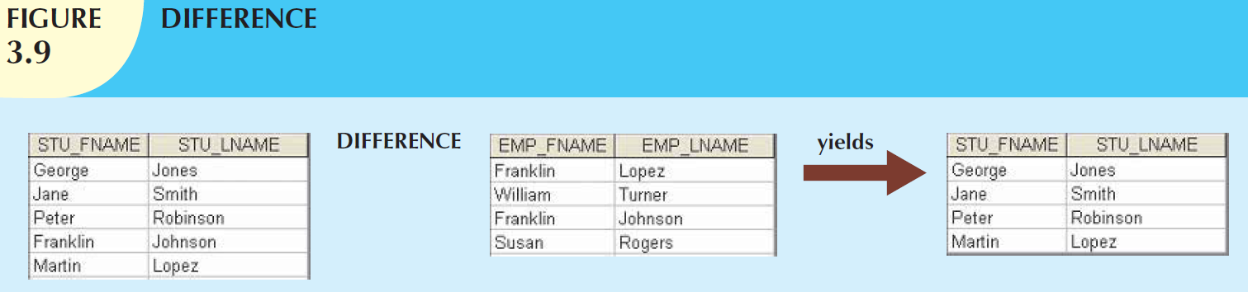
DIFFERENCE 差
Yields all rows in one table that are not found in the other table; that is, it subtracts one table from the other.
Mysql workbench 不支持except/difference运算符
use school;
SELECT * FROM `student table`
where `student table`.Sid not in (select Sid from `enroll table` where CourseID = 102);

Slide 13
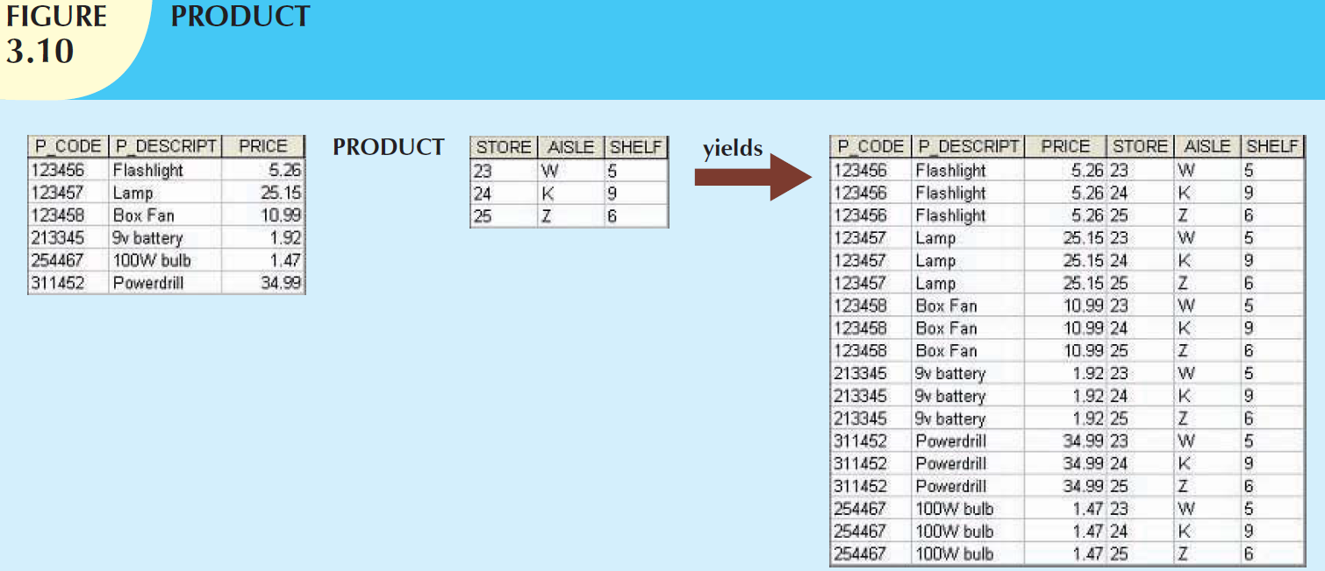
PRODUCT 笛卡尔积
Yields all possible pairs of rows from two tables
—also known as the Cartesian product.
SELECT * FROM `student table` S1 join `student table2`;

Slide 14
JION 连接
JOIN allows information to be combined from two or more tables.
Natural join
Inner join
Outer join
Equijoin

Slide 15
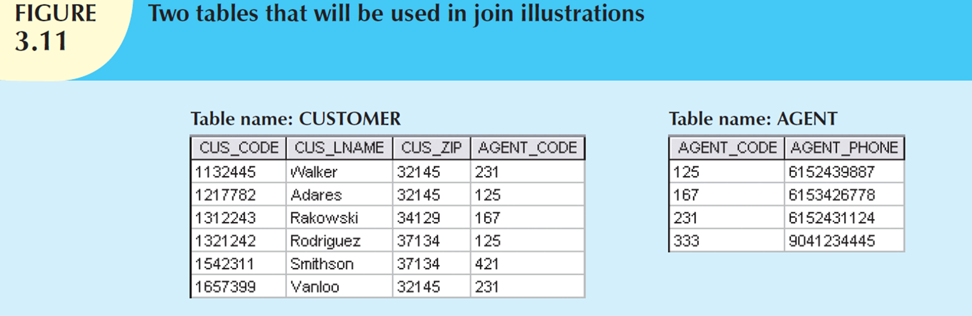
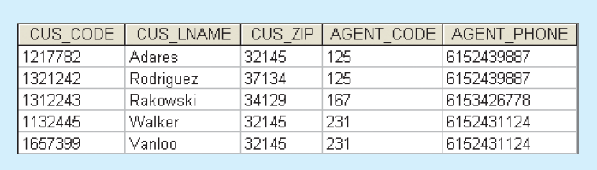
A natural join links tables by selecting only the rows with common values in their common attribute(s).
SELECT * FROM school.`student table` natural join school.`enroll table`;

Slide 16
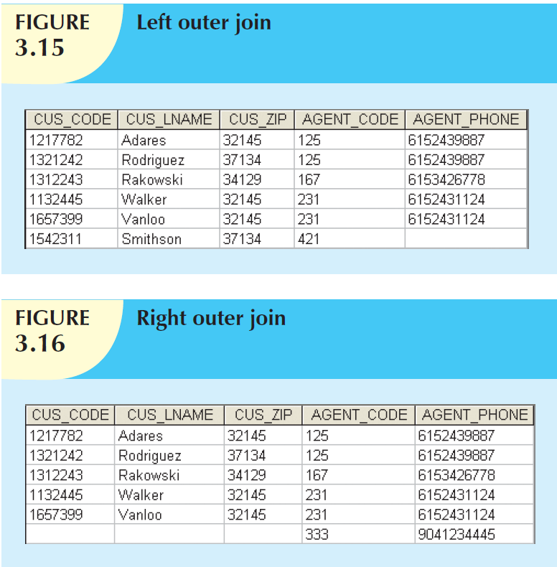

Slide 17
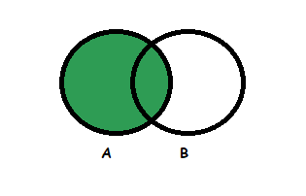
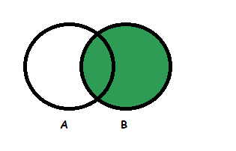
Join
Left Outer Join: Left Outer Join returns all the rows from the table on the left and columns of the table on the right is null padded. Left Outer Join retrieves all the rows from both the tables that satisfy the join condition along with the unmatched rows of the left table.
Right Outer Join: Right Outer Join returns all the rows from the table on the right and columns of the table on the left is null padded. Right Outer Join retrieves all the rows from both the tables that satisfy the join condition along with the unmatched rows of the right table.

Slide 18
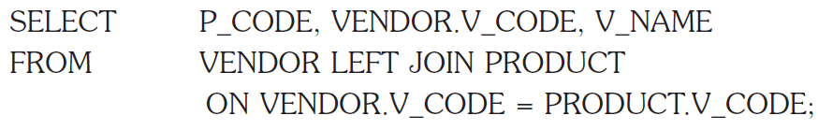
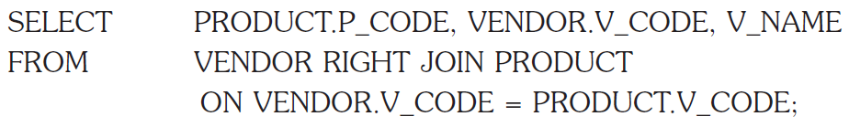
7.8.3 Outer joins 外连接
There are two types of outer joins: left and right.

Slide 19
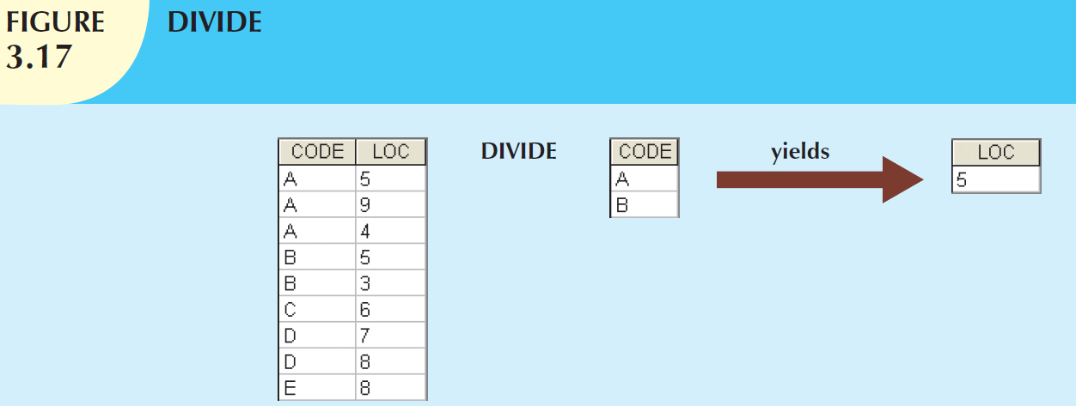
DIVIDE 除
use school;
SELECT * FROM `student table`
where `student table`.Sid in (select Sid from `enroll table` where CourseID = 102);
Divisor: one single-column table
Dividend: one 2-column table
Both tables have a common column

